Slide 1
Profit Maximization in Reliability Aware and Deadline Guaranteed Cloud Storage Systems
Kartik Verma 190101044
Vineet Agarwal 190101099
Supervisor - Prof. Aryabartta Sahu

Slide 2
Contents
Introduction
System Model
Problem Statement
Solution Approach
Request Allotment
Replica Creation
Workload Consolidation
Server Pairing
Server Wakeup
Experimental Evaluations
Conclusion
Future Work
References

Slide 3
Related Work
Critical analysis of 8 recent research works on cloud systems.
Covering QoS aware scheduling, profit maximization techniques, multi-tier cloud systems and vehicular networks.
Formulated problem around two.
Deadline Guaranteed storage service (DGCloud) satisfy requests with SLO satisfying at least a given percentage of requests within a given deadline.
Reliability aware and Cost effective job scheduling algorithm, TDLSTM predict server reliability.

Slide 4
Introduction
Surge in companies moving their storage to cloud data centers.
Problems faced by the cloud data storage services are
issue of unpredictable performance and high data latency.
This is due to server overload caused by
multiplexing of resources between tenants for higher utilization of servers and network infrastructure.
Service Level Objective (SLO) constrains the percentage of each tenant’s data access requests failing to meet its required deadline below a threshold.
Aim - maximize the profit earned by the cloud service provider while satisfying the SLO.

Slide 5
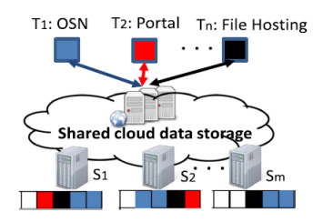
Introduction
The systems consists of
N tenants each
requesting a set of data partitions and
different SLO requirements.
Cloud storage service provider has
M servers each of which
stores different set of data partitions and
has a reliability associated with storage and network faults.

Slide 6
System Model
Set of M data servers {s₁,s₂… s_{m}}
different storage (c_{j}) and service capacity (𝜇_{j}).
different reliability and cost, re-evaluated timely.
Set of N tenants {t₁,t₂ … t_{n} } each with a
Reliability requirement Ɛ_{k}.
Deadline requirement d_{k}.
Every request is characterized by its reliability and deadline requirements.
A request can ask for multiple data partitions and can be scheduled on multiple servers.

Slide 7
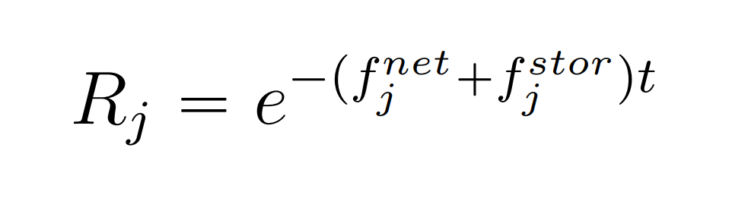

Servers
Each server has a network fault rate (f_{j}^{net} ) and storage fault rate (f_{j}^{stor} )
Using these fault rates, the server reliability can be calculated as:-
Each server has a maintenance cost per request MC_{j} and a service cost per unit size SC_{j}.
Using the mathematical model in Liu et. al, we calculated the deadline-guaranteed request arrival rate for each server 𝜆’_{j}.
The value of 𝜆’ depends on the tenants currently being served by the server and must be recalculated whenever the server serves a request from a new tenant.

Slide 8
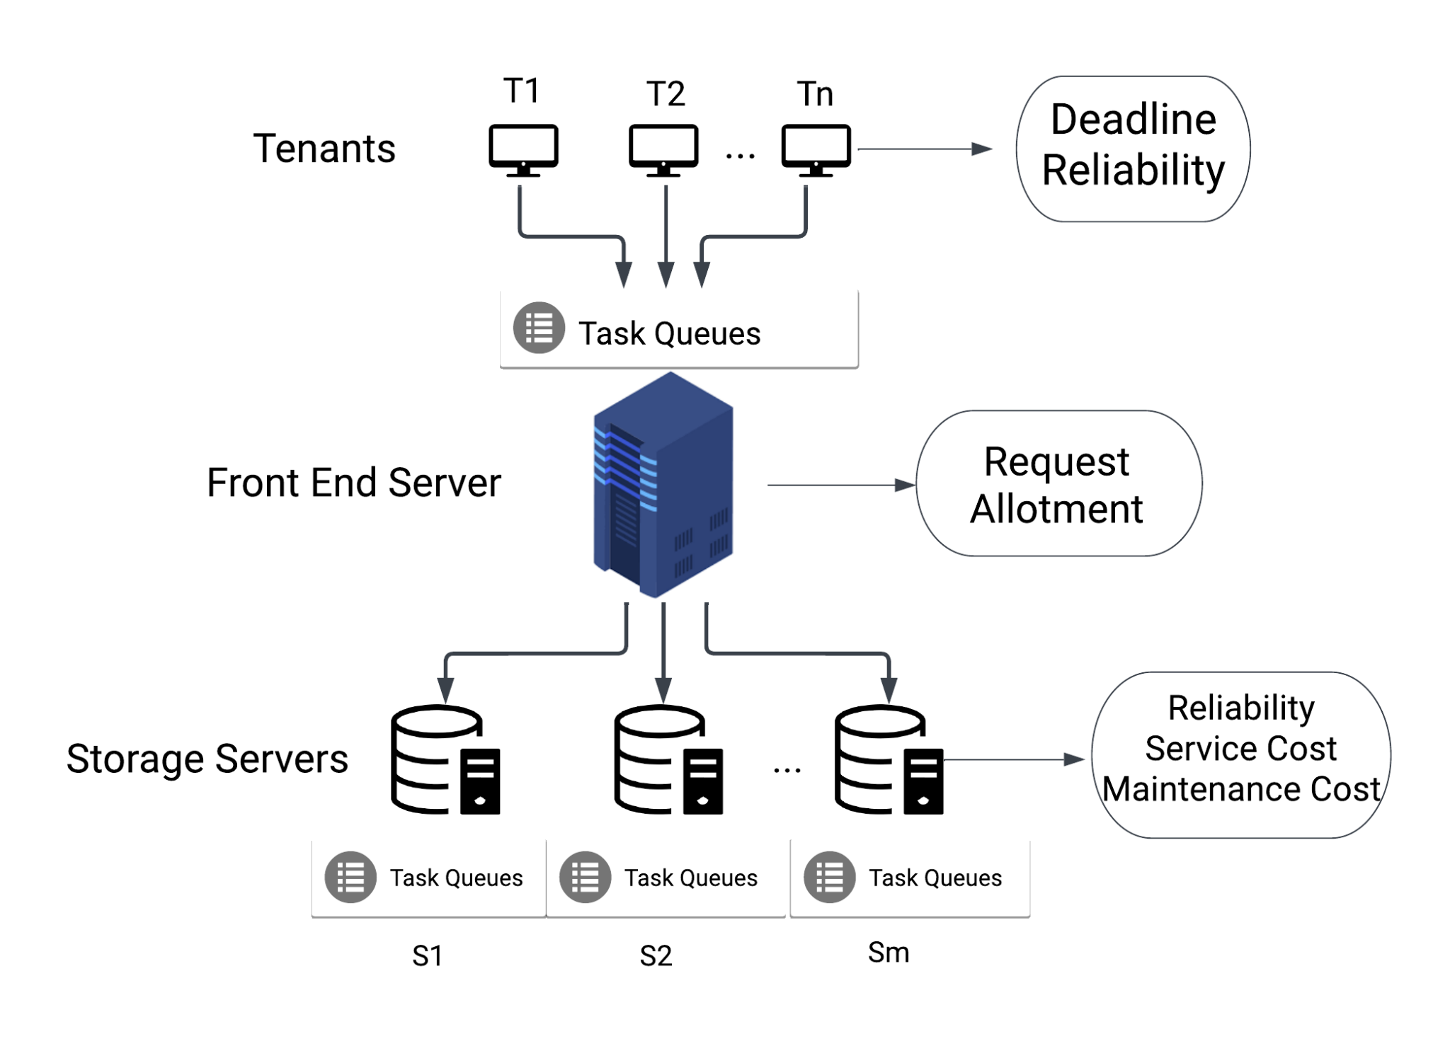
In-depth view of system model

Slide 9
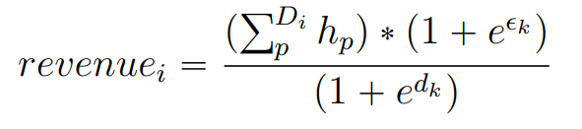
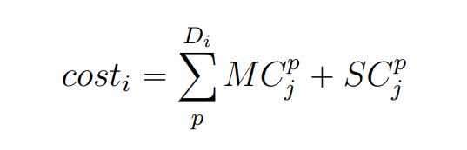
Problem Statement
Our aim is to :-
Maximize the profit earned by the cloud service provider.
Satisfy the reliability and deadline requirement of all the incoming requests.
The revenue generated by satisfying a request is formulated as:
The cost incurred by the front end server to execute the request:-

Slide 10
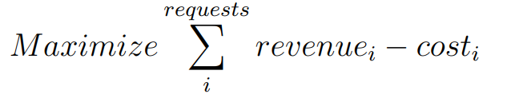
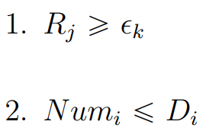
Problem Statement
The problem statement can thus be formulated as:-
under the constraints :-
Constraint 1 states that the reliability of each server on which the request is scheduled must be greater than expected reliability.
Constraint 2 states that the number of servers the request is scheduled on must be less than or equal to the number of data partitions requested.

Slide 11
Notations Used
Notation | Definition
s_{j} | Data Server j
t_{k} | Tenant k
ϵ_{k} | Tenant’s Expected Reliability
d_{k} | Tenant’s Expected Deadline
𝜆’_{j} | Deadline Guaranteed Request Arrival Rate for the j^{th} server
𝜆_{j} | Request Arrival Rate for the j^{th} server
f_{j}^{net} | Network Fault Rate for the j^{th} server
f_{j}^{stor} | Storage Fault Rate for the j^{th} server
MC_{j} | Maintenance Cost per request for the j^{th} server
SC_{j} | Storage Cost per unit for the j^{th} server
R_{j} | Reliability of the j^{th} server
𝜇_{j} | Service Capacity of the j^{th} server
D_{i} | Data partitions requested by the i^{th} request

Slide 12
Solution Approach
Our proposed algorithm consists of five modules :-
Request Allotment runs whenever a new request enters the system and allocates its to the servers.
Replica Creation finds the most suitable server to create a new data replica.
Workload Consolidation reduces the number of servers running and thus increase energy efficiency and reduces operational cost.
Server Pairing creates a list of backup servers for each server for a faster crash recovery.
Server Wakeup finds the most suitable server to wake up.

Slide 13
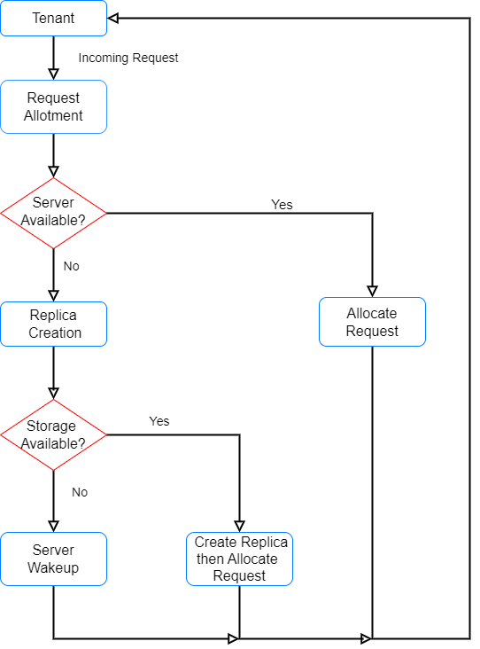
Workflow of request management system

Slide 14
Request Allotment
Runs when a new request is made by a tenant.
Input - Incoming Request Information and Server Information.
Output - Request allotment schedule.
Approach
Sort server list in non–increasing order of reliability.
Select first server with required reliability.
If tenant is not served by the server then recalculate 𝜆’ and schedule if 𝜆’ is > 0.
If no server found then execute Replica Creation.
Time complexity = O(mp) where m = # of servers and p = # of data partitions requested.

Slide 15
Replica Creation
Runs when a new request cannot be alloted to any of the existing servers.
Input - Incoming Request and Servers Information
Output - Request allotment schedule and Updated Servers Information
Approach
Sort existing servers in non-increasing order of available service capacity.
Check if server has enough storage available and server reliability is higher than requested reliability,if yes then create a data replica assign the request to this server.
If no such server is found then, Server Wakeup module is called.
Time Complexity - O(mlogm), where m = # of servers.

Slide 16
Workload Consolidation
Input :- Server Information
Output:- Updated Request Allotment
Approach
Sort the servers in increasing order of their utilization (𝜆_{j}/𝜆’_{j}).
For each server in this list check if we can reschedule the server’s request on an overloaded server.
If all the requests from a server are rescheduled then put server on sleep.
Time Complexity - O(m²r), where m = # of servers and r = maximum # of request in a server.

Slide 17
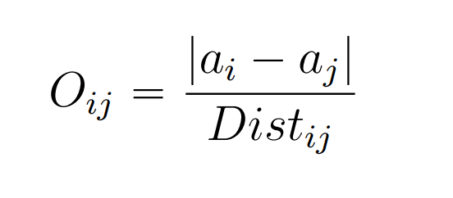
Server Pairing
Creates a list of three emergency/backup server of every server for faster crash recovery.
Each server has a list of three backup servers and each server can serve as a backup for utmost three other servers.
We define a coefficient which measures how favourable a server pairing is.It is formulated as
We calculate this coefficient for every server and select the three servers with the highest coefficient value under the constraint that there reliability should be greater than the current server’s reliability.
Time complexity = O(m²) where m = # of servers.

Slide 18
Server Wakeup
Runs when a new server needs to be woken up.
Input :- Data Partition , Sleeping Server Information
Output :- Updated Request Allotment
Approach
Sort the server in increasing order of their cost.
Find the first server whose reliability is greater than the tenant’s requested reliability and has the requested data partition.If found then wake up and allocate the request.
If no such server found then we create a data replica on one of the sleeping servers.
Time complexity - O(mlogm) where m = # of servers.

Slide 19
Experimental Evaluations
Evaluation Metrics :-
Success Rate - It is the ratio of the request that are successfully satisfied within the given deadline by the user. The higher the ratio the better our system is and it is expected that success rate is greater than the requested reliability.
Profit per Request - It is the amount of money earned by the service provider averaged over the total number of incoming requests.

Slide 20
Synthetic Dataset
The storage capacity and the service capacity of each server were initialized randomly.
The server network and storage fault rates follow a Poisson Distribution.
There are 100 tenants and arrival of new requests from them follows a Poisson Distribution.
Reliability requirement -
75% between [0.9-1.0)
15% between [0.8-0.9), and
remaining 10% less than 0.8.

Slide 21
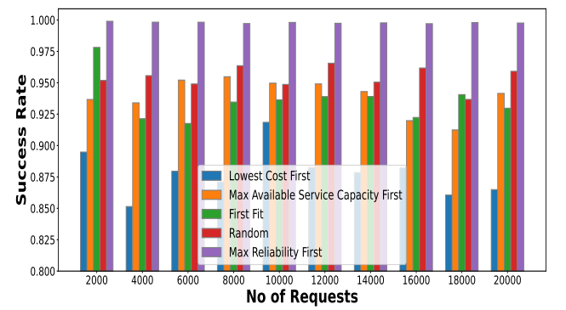
Success Rate vs Number of Requests
Max reliability first (proposed approach) outperforms every other approach in terms of success rate.

Slide 22
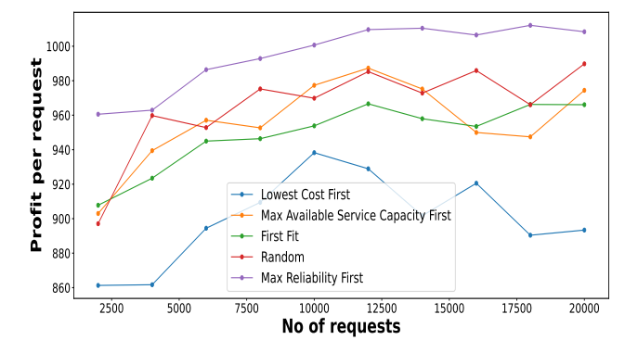
Profit per Request vs Number of Requests
Max reliability first (proposed approach) outperforms every other approach in terms of profit per request primarily because of the high success rate.

Slide 23
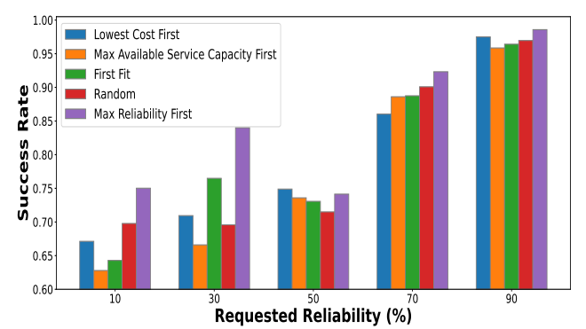
Success Rate vs Requested Reliability
Max reliability first (proposed approach) outperforms others. Difference decreases as reliability increases, because gradually all requests are scheduled only on highly reliable servers (>90%).

Slide 24
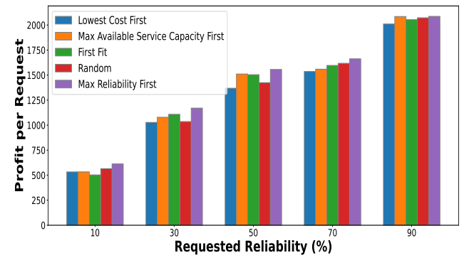
Profit per Request vs Requested Reliability
Max reliability first (proposed approach) outperforms others but again difference in profit reduces.

Slide 25
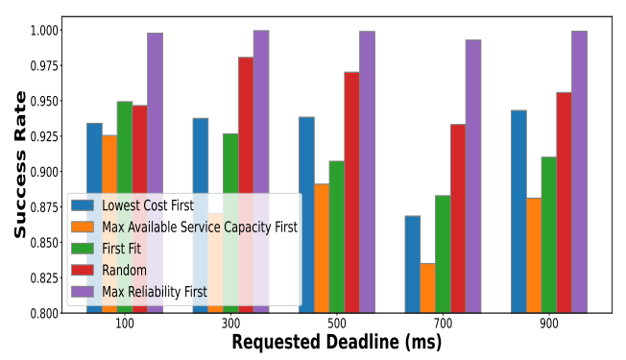
Success Rate vs Requested Deadline
Max reliability first (proposed approach) outperforms every other approach in terms of success rate.

Slide 26
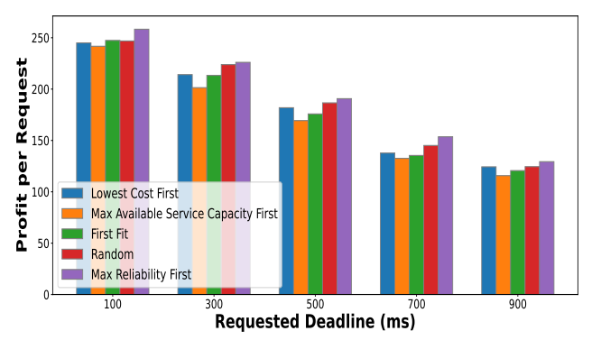
Profit per Request vs Requested Deadline
Max reliability first (proposed approach) outperforms others and profits decrease with increasing deadline as revenue generated for executing a request is inversely proportional to deadline.

Slide 27
Real Dataset
Traces for requests to Netflix and Spotify servers were used.
Server information is still synthetically generated.
Tenants have deadline and reliability requirements :-
Netflix -
Premium (0.6 units, 0.8%),
Standard (0.75 units, 0.6%), and
Free (0.9 units, 0.45%)
Spotify -
Premium (0.6 units, 0.8%) and
Free (0.9 units, 0.45%).
A single day is considered as unit timestamp.

Slide 28
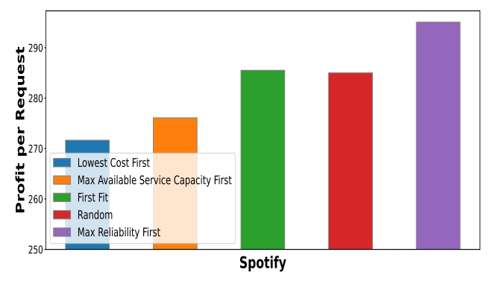
Profit per Request for Spotify
Max reliability first (proposed approach) outperforms every other approach in terms of success rate.

Slide 29
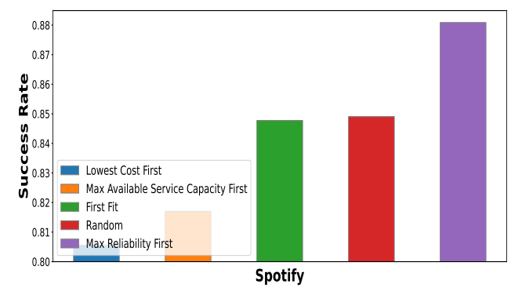
Success Rate for Spotify
Max reliability first has a success rate of 0.89 and significantly outperforms other approaches.

Slide 30
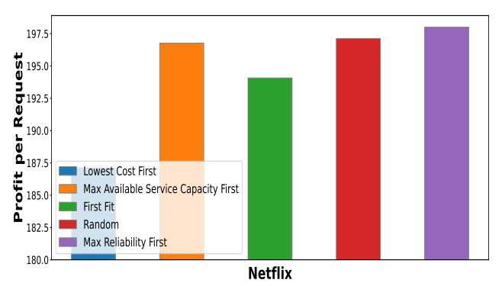
Profit per Request for Netflix
Max reliability first (proposed approach) outperforms every other approach in terms of success rate although the difference is close due to higher number of high reliability requests.

Slide 31
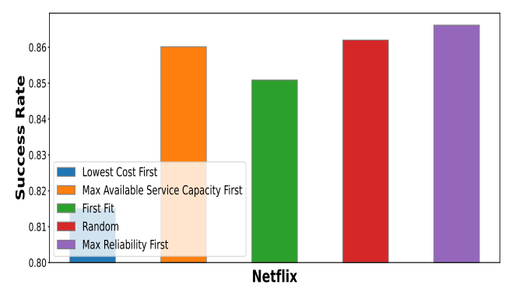
Success Rate for Netflix
Max reliability first (proposed approach) outperforms every other approach in terms of profit per request.

Slide 32
Conclusion
We critically analysed the literature survey to formulate the problem with maximum scope of improvement.
Problem - Profit Maximization in Reliability Aware and Deadline Guaranteed Cloud Storage Systems.
Proposed Approach - We analysed different approaches and proposed Maximum Reliability First approach for request allotment.
Energy Efficient Solutions - Workload consolidation and Server Pairing procedures improve the energy and cost efficiency.
Experimental Evaluation - Our proposed approach outperformed the benchmark First Fit approach, increasing profits by 6% and increasing the success rate from 93.6% to 99.8%.

Slide 33
Future Work
Going forward we aim to :-
Model our work for M/M/c queuing model.
Include dynamic cancellation of requests in the system model.

Slide 34
References
G. Liu, H. Shen, H. Wang and L. Yu, ”Towards Deadline Guaranteed Cloud Storage Services,” in IEEE Transactions on Services Computing, vol. 14, no. 3, pp. 915-929, 1 May-June 2021, doi: 10.1109/TSC.2018.2824831.
C. Peng, M. Kim, Z. Zhang, and H. Lei, “Dynamo: Amazon’s highly available key-value store,” in Proc. ACM SIGOPS Symp. Operating Syst. Principles, 2007, pp. 205–220.
A. K. Singh, X. Cui, B. Cassell, B. Wong, and K. Daudjee, “MicroFuge: A middleware approach to providing performance isolation in cloud storage systems,” in Proc. IEEE Int. Conf. Distrib. Comput. Syst., 2014, pp. 503–513.
A. Cidon, S. Rumble, R. Stutsman, S. Katti, J. Ousterhout, and M. Rosenblum, “Copysets: Reducing the frequency of data loss in cloud storage,” in Proc. USENIX Conf. Annu. Tech. Conf., 2013, pp. 37–48
E. Thereska, A. Donnelly, and D. Narayanan, “Sierra: Practical power-proportionality for data center storage,” in Proc. 6th Conf. Comput. Syst., 2011, pp. 169–182.
A. J. Gonzalez, B. E. Helvik, P. Tiwari, D. M. Becker, and O. J. Wittner, “GEARSHIFT: Guaranteeing availability requirements in SLAs using hybrid fault tolerance,” in Proc. IEEE INFOCOM, 2015, pp. 1373–1381.
G. L. Stavrinides and H. D. Karatza, ”An energy-efficient, QoSaware and cost-effective scheduling approach for real-time workflow applications in cloud computing systems utilizing DVFS and approximate computations,” Future Generation Computer Systems, vol. 96, pp. 216-226, Jul. 2019.
Tang, Xiaoyong Liu, Yi Zeng, Zeng Veeravalli, Bharadwaj. (2021). Service Cost Effective and Reliability Aware Job Scheduling Algorithm on Cloud Computing Systems. IEEE Transactions on Cloud Computing. PP. 1-1. 10.1109/TCC.2021.3137323.
P.K. Sahoo, C.K. Dehury, and B. Veeravalli, ”LVRM: On the Design of Efficient Link Based Virtual Resource Management Algorithm for Cloud Platforms,” IEEE Trans. Parallel Distributed Syst., vol. 29, no. 4, pp. 887-900, Apr. 2018
S. Long, W. Long, Z. Li, K. Li, Y. Xia, and Z. Tang, ”A Game-Based Approach for Cost-Aware Task Assignment With QoS Constraint in Collaborative Edge and Cloud Environments,” IEEE Trans. Parallel and Distributed Systems, vol. 32, no. 7, pp. 1629-1640, July 2021.
X. Zhu, J. Wang, H. Guo, D. Zhu, L. T. Yang, and L. Liu, ”Fault-Tolerant Scheduling for Real-Time Scientific Workflows with Elastic Resource Provisioning in Virtualized Clouds,” IEEE Trans. Parallel and Distributed Systems, vol. 27, no. 12, pp. 3501- 3517, Dec. 2016
X. Li, Y. Liu, R. Kang, and L. Xiao, ”Service reliability modeling and evaluation of active-active cloud data center based on the IT infrastructure,” Microelectronics Reliability, vol. 75, pp. 271-282, Aug. 2017.
A. Dogan and F. Ozg¨ner, ”Matching and scheduling algorithms for minimizing execution time and failure probability of applications in heterogeneous computing,” IEEE Trans. Parallel and Distributed Systems, vol. 13, no. 3, pp. 308-323, Mar. 2002.
X. Tang, K. Li, and G. Liao, ”An effective reliability-driven the technique of allocating tasks on heterogeneous cluster systems,” Cluster Computing, vol. 17, no. 4, pp. 1413- 1425, Dec. 2014.

Slide 35
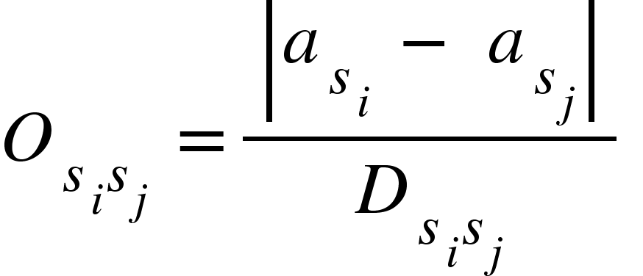
Thank You

